Slide 1
Robbin L. Marcus
www.robbinlmarcus.com
Alexander Technique
for Music Teachers
Teaching Comfortably While Remaining Highly Organized
Presented Virtually
February 20, 2021
For the Kodály Educators of Southern New England

Slide 2
Class Generated list of Issues
Music Teachers Face
This list was generated by music teachers in Robbin Marcus’
2018 Alexander Technique for Music Teachers summer class at George Mason University in Virginia.
Getting up and down off the floor
Teachers and Students sitting Criss-Cross Applesauce
Numbness While Sitting on the Floor
Standing on a concrete/tile floor all day
Playing a song over and over on the piano
Tense shoulders from computer work
Neck pain and tension

Slide 3
Class Generated list of Issues
Music Teachers Face
(Continued)
Singing all day, clenching jaw TMJ
Tongue Tension and hoarseness
Staying relaxed while conducting
Lifting instruments up and down
Ways to modify playing technique for various size instruments
Recorder playing posture (students)
Loading and unloading/lifting

Slide 4
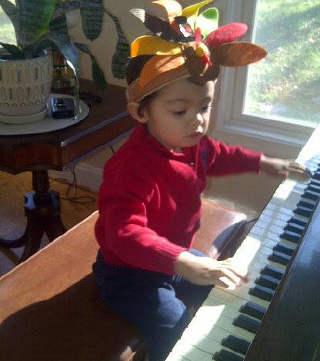
Natural poise and grace

Slide 5
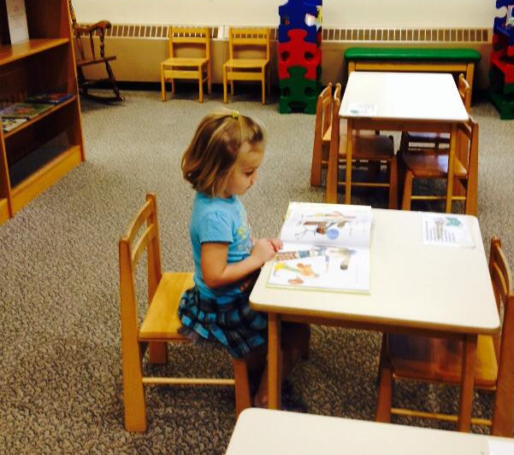
Head balanced on top of spine

Slide 6
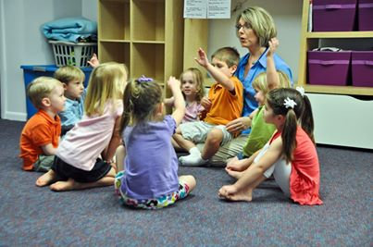

Slide 7
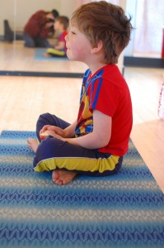
Criss-Cross Problem-Sauce
Head is not balanced on top of spine Note Rounded back Child is rotated back off of sitz bones

Slide 9
Adulthood

Slide 10
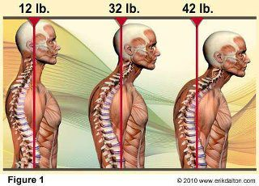
Spine Health = 10 lbs of pressure per inch

Slide 11
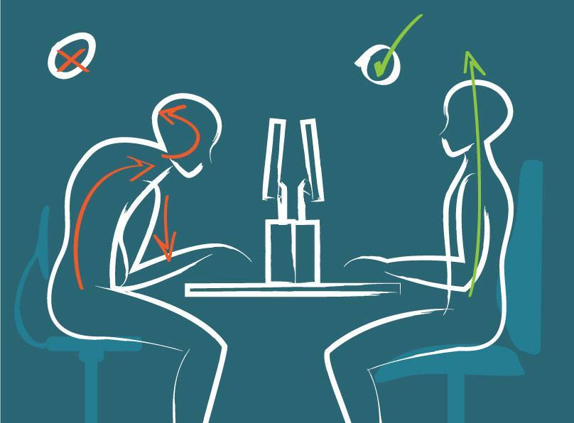
Where and how we spend our time
Head forward posture Properly aligned use

Slide 12
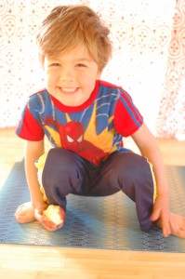
Alternatives:
Squatting
Allows length of spine
Good for hip flexibility
Most natural seated position of mankind
FM Alexander called squatting “our birthright”.

Slide 13
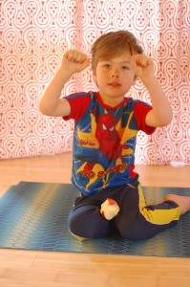
Alternatives:
Side Seat
Allows length of spine
Allows for postural muscles to stretch
Easier on the spine than cross legged done poorly.

Slide 14
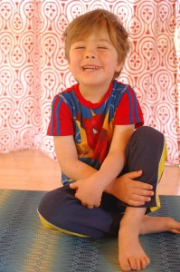
Alternatives:
Modified Side Seat
Allows the child to hold onto one leg to rest the muscles of the back.
Spine is still long.

Slide 15
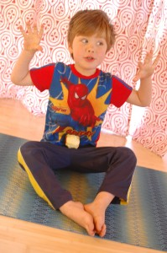
Alternatives:
Diamond Seat
Helps the child find his sitz bones.
Improved spine length over other positions
Keeps the hamstrings flexible.

Slide 16
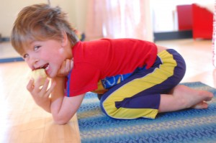
Alternatives:
Rest Position
Allows the child to rest the postural muscles.
Child’s pose in yoga.
Photos courtesy of Kristen Fryer, from her blog post:
http://www.happyspine.us/2013/04/why-criss-cross-apple-sauce-is-bad-for-school-children/

Slide 17
Criss Cross
Modified Child Pose
Modified
Side Seat
Diamond Seat

Slide 18
About Robbin Marcus
Robbin Marcus is an ATI Certified Alexander Technique Teacher with a studio in Decatur, GA.
Robbin teaches private lessons virtually from her home until further notice.
Contact information:
Phone: 670-720-8717
Email: robbin@robbinmarcusmusic.com
Website: https://www.robbinlmarcus.com/alexander-technique.html
Facebook: www.facebook.com/AlexanderTDecatur
Robbin also teaches piano lessons to students of all ages. She is the Director Emeritus of the George Mason University Summer Kodály Program.

Slide 19
Robbin L Marcus
www.RobbinLMarcus.com
RobbinLMarcus@gmail.com
More Alexander Technique Information
Alexander Technique Informational Websites:
www.alexandertechnique.com
www.robbinlmarcus.com/alexander-technique.html
Robbin on Facebook: www.facebook.com/AlexanderTDecatur
Alexander Technique International
www. https://www.ati-net.com/index.php

