Slide 1
Robbin L. Marcus
www.robbinlmarcus.com
Alexander Technique
for Musicians
Making Music with Ease
Presented
September 7, 2022
For the Spellman College Music Department
Health and Wellness Series

Slide 2
The Alexander Principles
1) Awareness
2) Inhibition (pause)
3) Directions

Slide 3
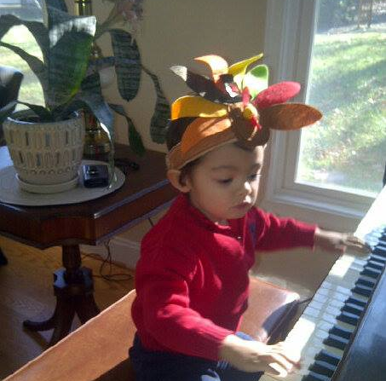
Natural poise and grace
When we begin, we all look like this.

Slide 4
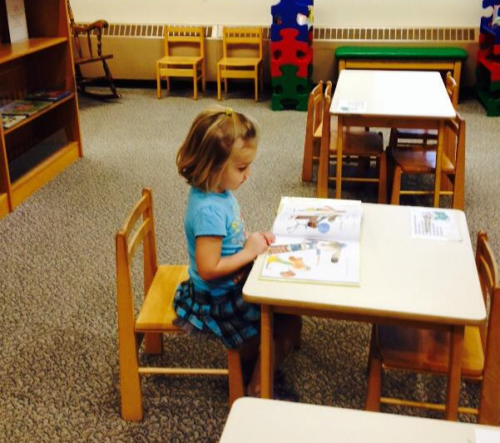
Head balanced on top of spine

Slide 5
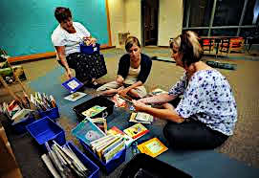
Adults Sitting

Slide 6
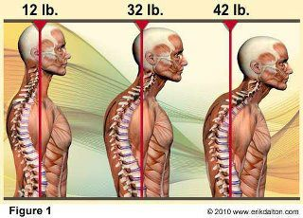
Spine Health = 10 lbs of pressure per inch

Slide 7
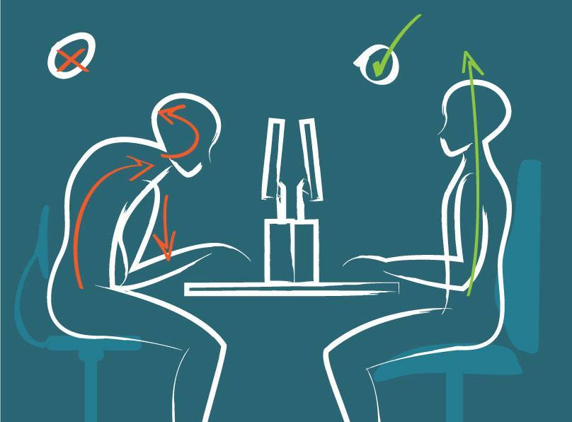
Where and how we spend our time
Head forward posture Properly aligned use

Slide 8
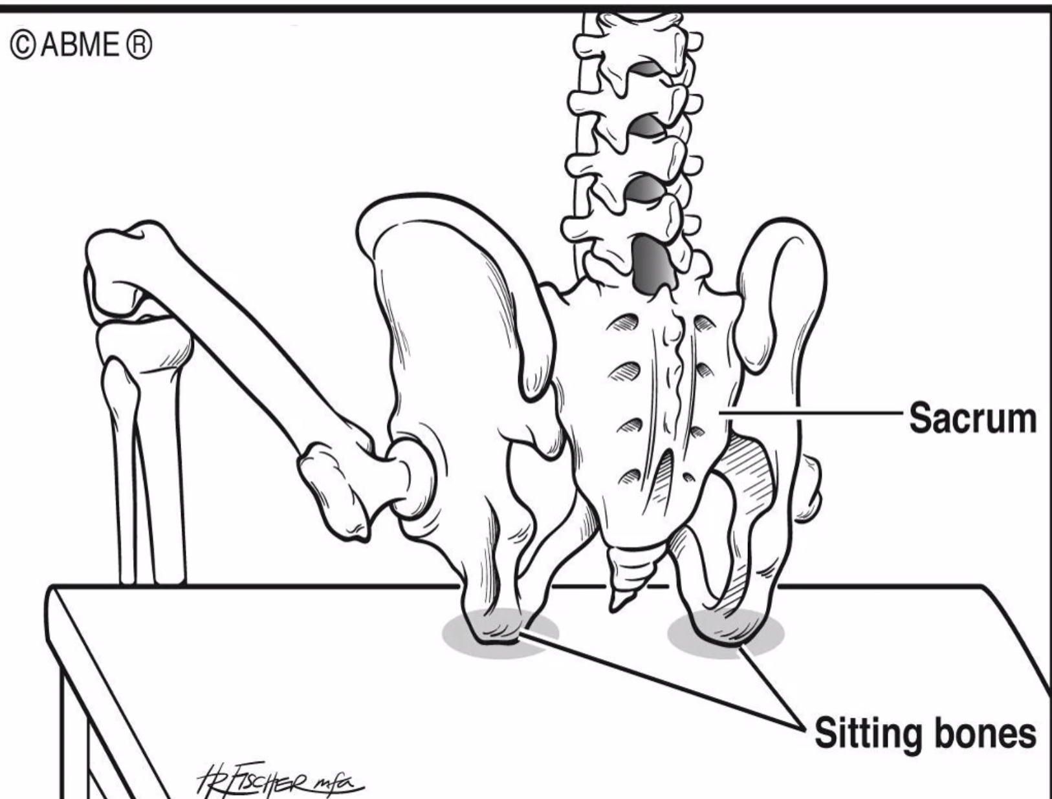
Where are my sit bones?

Slide 9
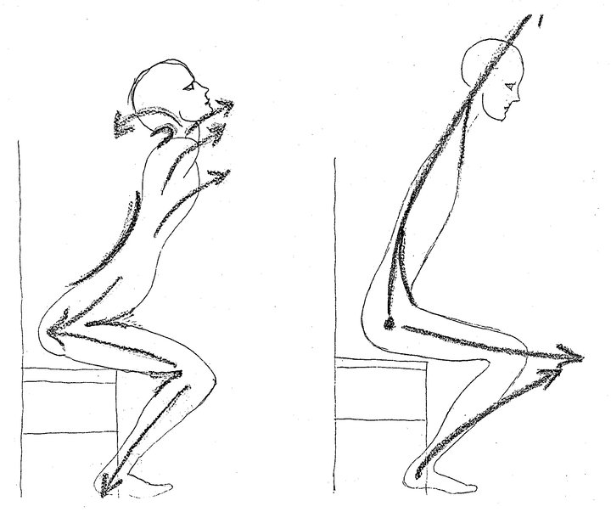
Getting up with ease from a seat

Slide 10
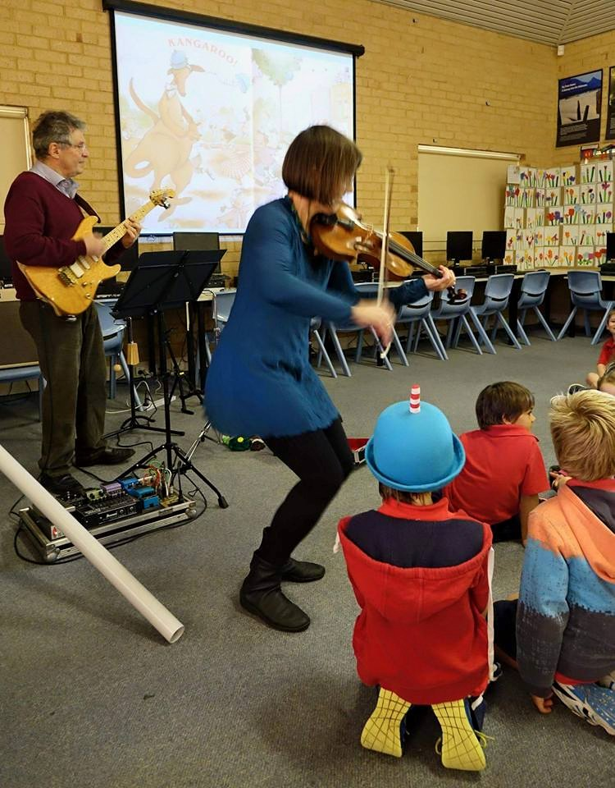
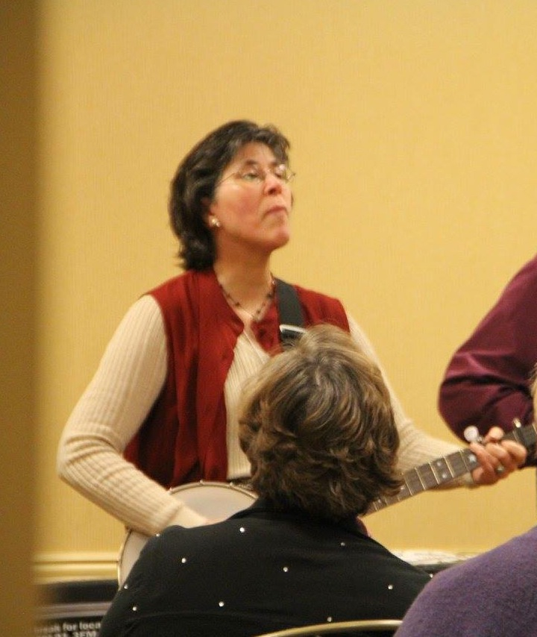
Contrasts in poise and ease

Slide 11
The Alexander Principles
1) Awareness
2) Inhibition (pause)
3) Directions

Slide 12
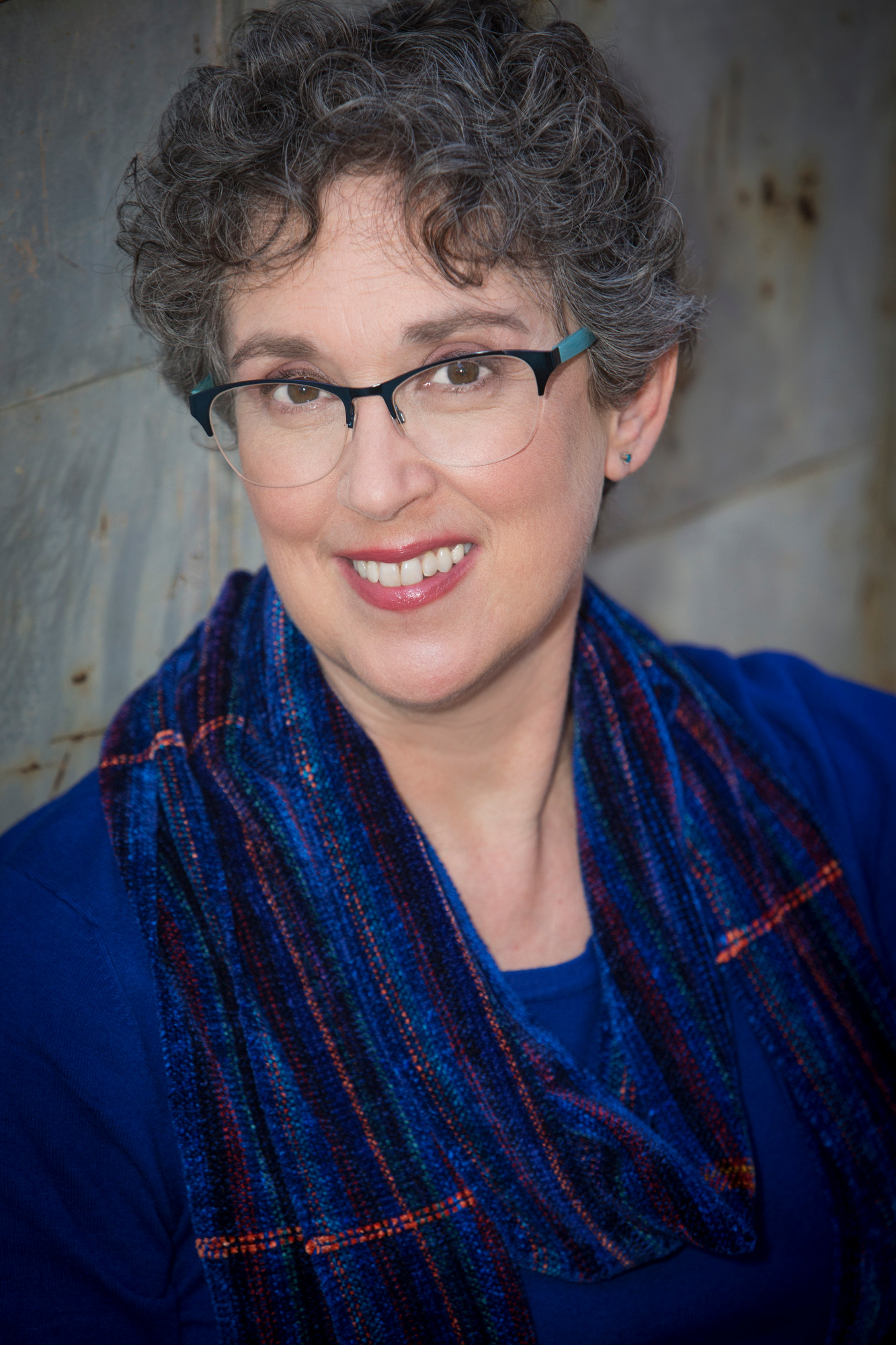
About Robbin Marcus
Robbin Marcus is an ATI Certified Alexander Technique Teacher with a studio in Decatur, GA.
Robbin teaches private lessons and classes at the First Christian Church of Decatur, 601 W Ponce de Leon Ave, Decatur GA.
Contact information:
Phone: 670-720-8717
Email: robbin@robbinmarcusmusic.com
Website: https://www.robbinlmarcus.com/alexander-technique.html
Facebook: www.facebook.com/AlexanderTDecatur
Robbin also teaches piano lessons to students of all ages. She is the Director Emeritus of the George Mason University Summer Kodály Program.

Slide 13
Robbin L Marcus
www.RobbinLMarcus.com
RobbinLMarcus@gmail.com
More Alexander Technique Information
Alexander Technique Informational Websites:
www.alexandertechnique.com
www.robbinlmarcus.com/alexander-technique.html
Robbin on Facebook: www.facebook.com/AlexanderTDecatur
Alexander Technique International
www. https://www.ati-net.com/index.php

